Slide 1

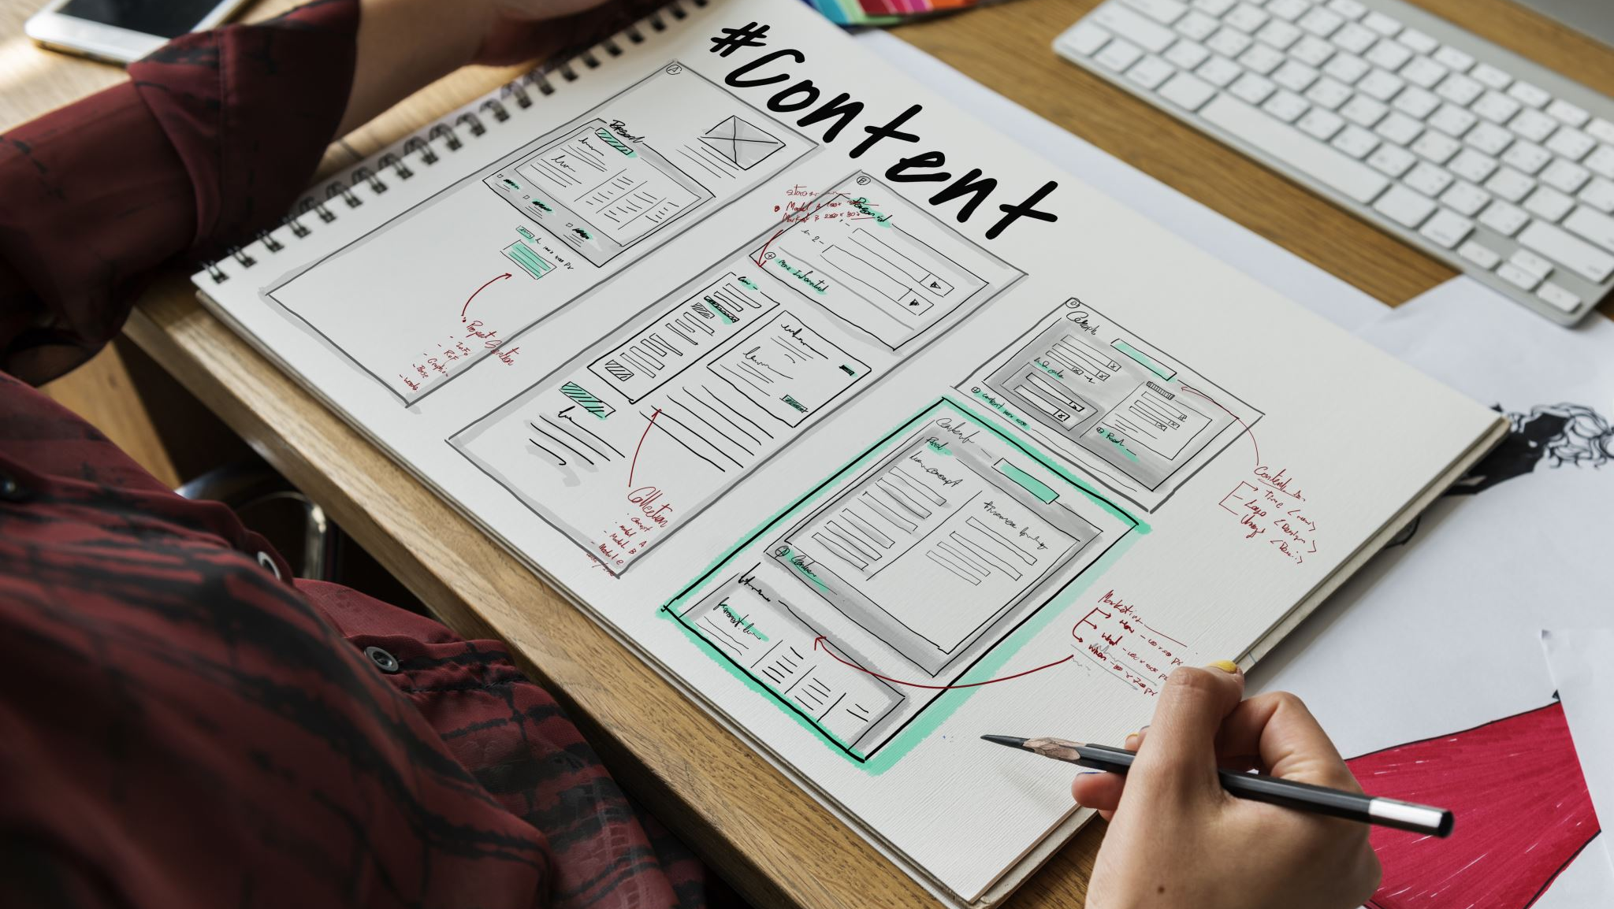
BIIT 2305 Web Application Development
Instructor :
Dr. Najhan M. Ibrahim
Department of Information Systems
Kulliyyah of ICT, IIUM.

Slide 2

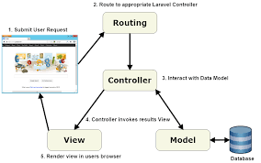

MVC

Slide 3


outline
What is controller
How to make controller
How to Make function in controller
How to Call controller from Routing
Controller with resources

Slide 4

Laravel controller

Slide 5

Introduction to controller
Instead of defining all of your request handling logic in a single routes.php file,
you may wish to organize this behavior using Controller classes.
Controllers can group related HTTP request handling logic into a class.

Slide 6
Introduction to controller cont..
For example,
a UserController class might handle all incoming requests related to users, including showing, creating, updating, and deleting users.
By default, controllers are stored in the app/Http/Controllers directory.

Slide 7
Controllers
Controllers is central unit of any MVC framework.
It is also can be considered as a classes that organize logic of one or more routes together in one place.
Controllers group similar routes together especially when you work on CRUD (Create, Read, Update and Delete) format.

Slide 8
How to Make controller
Create a controller manually (by right click, not advisable)
Create a controller using PHP artisan
php artisan make:controller UserController

Slide 9
Default Generated Controller
<?php
namespace App\Http\Controllers;
use Illuminate\Http\Request;
class TestCon extends Controller
{
//
}

Slide 10
Make function in controller
<?php
namespace App\Http\Controllers;
use Illuminate\Http\Request;
class Users extends Controller
{
//
public function index()
{
echo "Hello from controller";
}
}

Slide 11
How to call controller
//routes/web.php
//Include the controller in your route
use App\Http\Controllers\product;
Route::get(‘URL’, “controller file”);
Example
Route::get(‘product’,[Product::class,’index’]);

Slide 12
Passing data using compact method
public function index()
{
//echo "Hello from controller";
$x = "Controller Number is:";
$y = 5;
return view('products', compact('x','y'));
}
}

Slide 13
Resources controller
It is a generator that allows developer to predefine Laravel route definition and bind entire resource controller at once
php artisan make:controller myController --resource

Slide 14
List of generated resources
index() – show all data.
create() – show the create data form.
store() – accept form submission from the data form.
show() – show one data.
edit() – edit one data.
update() – accept form submission from the edit data form.
destroy() – delete one data.

Slide 15
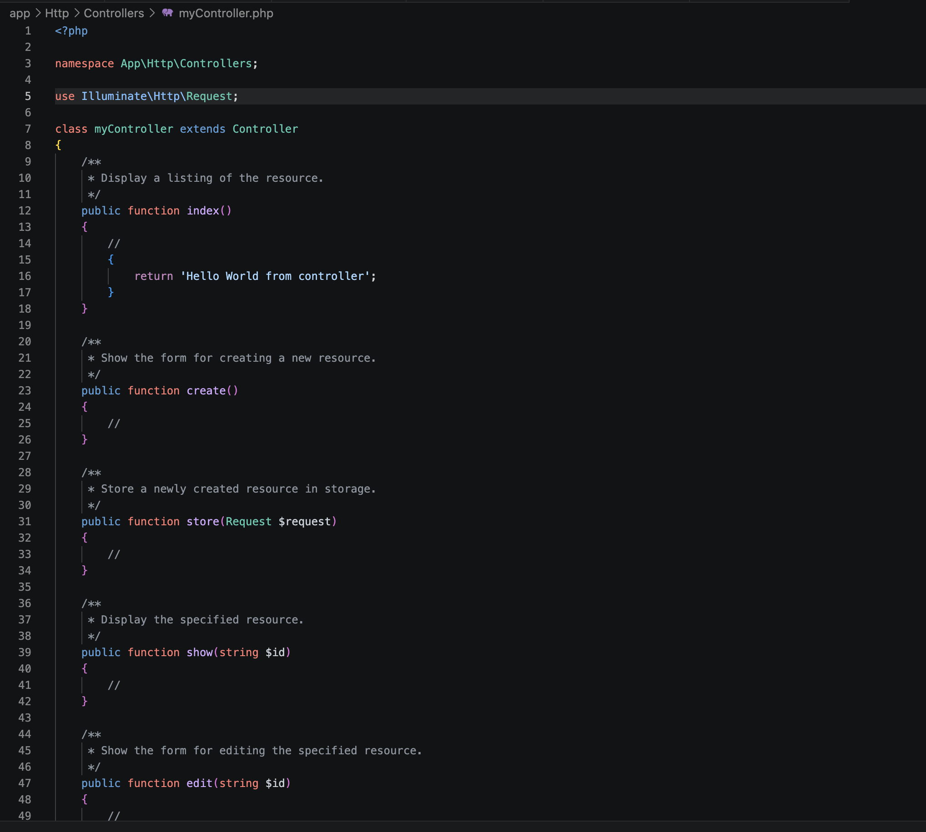

Slide 16
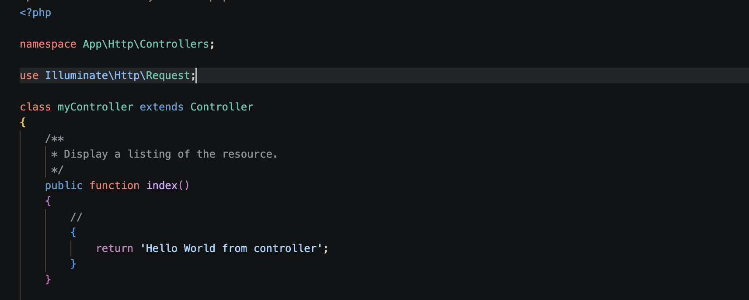
index()

Slide 17
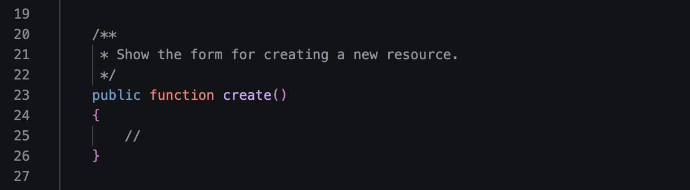
create()

Slide 18
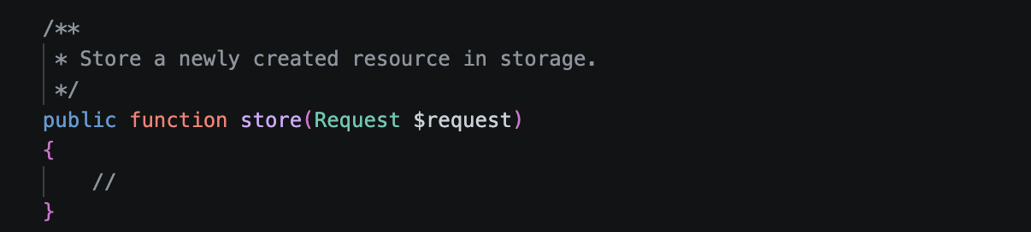
store()

Slide 19
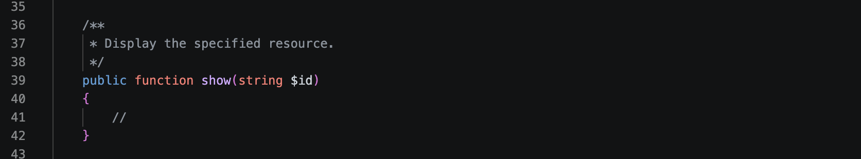
show()

Slide 20
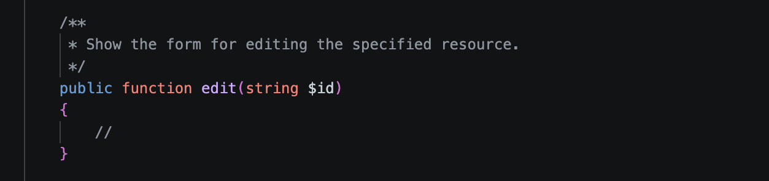
edit()

Slide 21
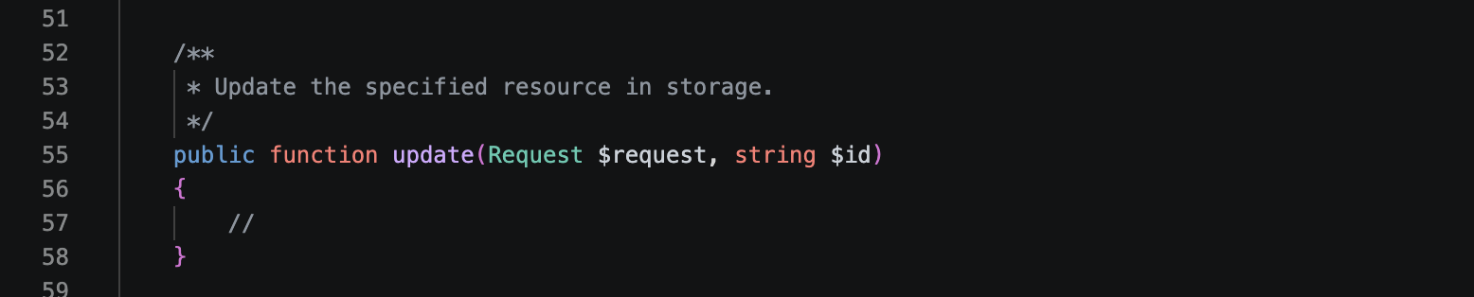
update()

Slide 22
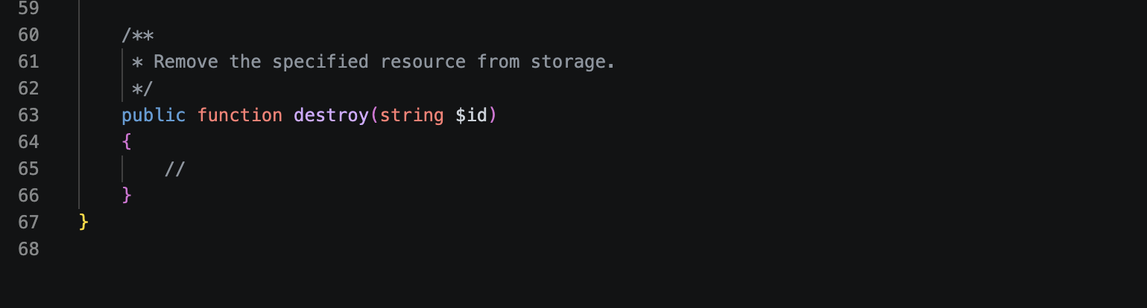
destroy()

